Slide 1
BREAST CANCER PREDICTION
Group: Y19-CP-DS&BDA-171
Guide:Dr.P.LAKSHMI PRASANNA
Group members:
190030449 G S Lahari
190031117 MURIKIPUDI NIKHIL
190031793 YARKAREDDY BHAVANA REDDY

Slide 2

ABSTRACT
In the developing world, cancer death is one of the major problems for humankind. Even though there are many ways to prevent it before happening, some cancer types still do not have any treatment. One of the most common cancer types is breast cancer. Early detection of breast cancer can dramatically improve the prognosis and chances of survival by allowing patients to receive timely clinical therapy. In this project, there are many studies about predicting the type of breast tumors. In this paper the detection of cancer cells is done by machine learning techniques. Machine learning techniques can bring a large contribute on the process of prediction and early diagnosis of breast cancer, became a research hotspot and has been proved as a strong technique

Slide 3

TECHNOLOGIES USED
Python
Machine learning
Data Science
Jypyter Notebook

Slide 4

IMPLEMENTATION
In breast cancer it is not necessary that symptoms will be show every time thus helping by taking proper precautions. So, early detection and its proper classification is the only way to lessen the cancer fatality and it is a major task in medical field.
The fundamental problems like ineffectiveness in capturing textural information as well as low retrieval performance caused by poor discrimination of capabilities of features.
Mammography is being used for early-stage detection diagnosis and screening. Key elements here are processing and analysis for better prognosis results. Using FCM technique, image segmentation is performed here. Further, certain features are extracted through these segmented images and trained. Now, the trained images are being classified by an efficient and accurate classifier.

Slide 5

INTRODUCTION

Slide 6
Breast cancer is a type of cancer that starts in the breast. Cancer starts when cells begin to grow out of control. Breast cancer cells usually form a tumor that can often be seen on an x-ray or felt as a lump. Breast cancer can spread when the cancer cells get into the blood or lymph system and are carried to other parts of the body. The cause of Breast Cancer includes changes and mutations in DNA. There are many different types of breast cancer and common ones include ductal carcinoma in situ (DCIS) and invasive carcinoma. Others, like phyllodes tumors and angiosarcoma are less common. There are many algorithms for classification of breast cancer outcomes.
Machine learning plays an important role for the classification of the breast cancer. There are many diagnosis processes that have discussed above provides the images. These types of diagnosis images are used for the classification using machine learning. Machine learning is a sub-field of AI. Many developers use the machine learning to re-train the existing models and for the better performance . Machine learning is used for the linear data. If the data is small, then machine learning gives better results but when the data is too large then it doesn’t give the better results. There are three main types of machine learning that are used to train the model. Supervised machine learning works on the known data and with the help of the supervisor. Unsupervised machine learning is taken without any supervision. Reinforcement machine learning is less in use. These algorithms catch the ideal information from past understanding to settle on the exact choices.

Slide 7
STEP TO STEP PROCESS
STEP 1
Pre-Processing Data
STEP 2
Data Preparation
STEP 3
Features Selection
STEP 4
Feature Projection
STEP 5
Feature Scaling
STEP 6
Model Selection
STEP 7
Prediction

Slide 8

DIFFERENT APPROACHES

Slide 9

Logistic Regression
K-Nearest Neighbour (KNN)
Support Vector Machine
Random Forest
Decision Tree

Slide 10

Logistic regression is a technique that firstly used for biological studies in the early twentieth century. It has become widespread for social studies too. Logistic regression is also one of the predictive analyses. Logistic regression is appropriate to use when there is one binary dependent variable and other independent variables. Linear and logistic regressions are different in terms of the dependent variable. Linear regression is a more appropriate technique for continuous variables

Slide 11
KNN is a supervised learning technique that means the label of the data is identified before making predictions. Clustering and regression are two purposes to use it. K represents a numerical value for the nearest neighbors. KNN algorithm does not have a training phase. Predictions are made based on the Euclidean distance to k-nearest neighbors. This technique is applied to the prediction of breast cancer dataset since it already has labels such as malignant and benign. The label is classified according to the nearest neighbor to the class labels of its neighbors
Predictions are made based on the Euclidean distance to k-nearest neighbors. This technique is applied to the prediction of breast cancer dataset since it already has labels such as malignant and benign. The label is classified according to the nearest neighbor to the class labels of its neighbors

Slide 12

Support vector machine is one of the most common machine learning techniques. The objective of the algorithm is to find a hyperplane in N-dimensions that classifies the data points. The major part of this algorithm is finding the plane that maximizes the margin.
N dimension diversifies based on the feature numbers. Comparing two features could be done smoothly. However, if there are several features for classification, it is not always that straightforward. Maximizing the margin provides more accurate prediction results

Slide 13
Random forest is an ensemble learning model that can be used for both regression and classification. Indeed, a random forest consists of many decision trees. Therefore, in some cases, it is more logical to use random forest rather than a decision tree.
Decision tree is one of the most common supervised learning techniques. Regression and classification are two main goals to use it. It seeks to solve problems by drawing a tree figure. Features are known as decision nodes, and outputs are leaf nodes. Feature values are considered as categorical in the decision tree algorithm. At the very beginning of this algorithm, it is essential to choose the best attribute and place it at the top on tree figure and then split the tree. Gini index and information gain are two methods for the selection of features.

Slide 14
Benefits of using Data science in this Process:
Getting data to one place makes it easier to analyse
Using Multiple criteria creates the correct context.
Having a broader perspective makes unknown risks visible.

Slide 15
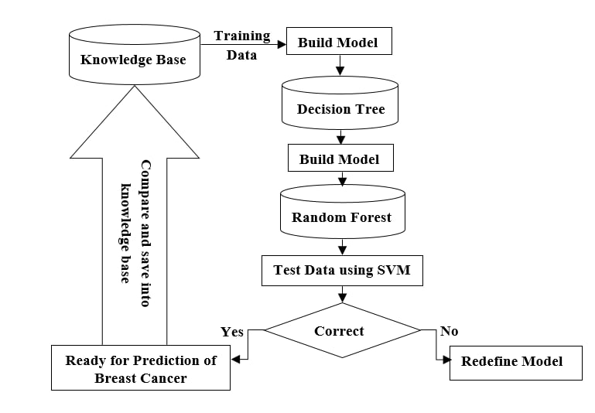
FLOW CHART

Slide 16

LITERATURE TABLE

Slide 17
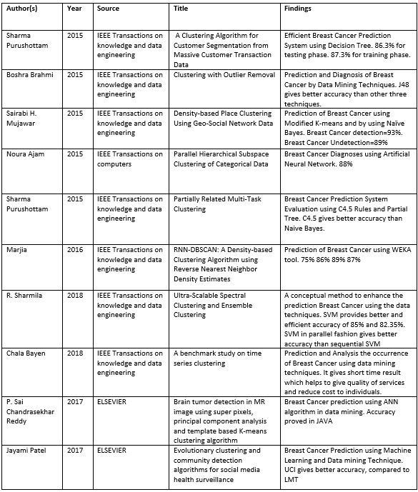

Slide 18
LITERATURE REVIEW

Slide 19
This section gives the information about the related work of the research that has been already done. Basically, two techniques are used to detect the breast cancer. First one is machine learning and second is deep learning. There are many researches that are conducted through the machine learning. But machine learning techniques have some problems that are removed through the deep learning. This section gives the information about machine and deep learning techniques.
Wang et al. studied to find the best way for breast cancer predictions by using data mining methods on several records. They applied support vector machine (SVM), artificial neural network (ANN), naïve Bayes classifier, and AdaBoost Tree. Reducing the feature space was discussed, then Principle Component Analysis (PCA) was applied with the aim of reduction. In the evaluation part of the performance of the models, they used two datasets that were the Wisconsin Breast Cancer Database (1991) and Wisconsin Diagnostic Breast Cancer (1995) [18,30]. They provided a detailed evaluation of the models and test errors.
Nithya et al. believe that the main problem of breast cancer is about classifying the breast tumor. Computer-Aided Diagnosis (CAD) has been used for the detection and characterization of breast cancer. Their main idea was improving breast cancer prediction by using data mining methods. Bagging, multiboot, random subspace to the classification performance of naïve Bayes, support vector machine-sequential minimal optimization (SVM-SMO), and multilayer perceptron were applied.

Slide 20
M. Tahmooresi et al. proposed another hybrid model based on machine learning. According to that, SVM was a good classifier that gave the better accuracy among the all. It had done the comparison between SVM, KNN, ANN and decision tree. It implemented on the images and blood dataset. As the consequence.
Muhammet Fatih Aslan et al. proposed the model on machine learning but used the different classifier. The classifier used by the author was Extreme Learning Machine, SVM, KNN and ANN. There was a bit change in classifier to find out the better results. According to that, Extreme Learning Machine gave the better results.
Anusha Bharat et al. proposed the model based on machine learning. It used the four classifier like SVM, decision tree (CART), KNN, Naïve bayes. According to author, KNN gave the better accuracy. There was limitation in SVM. SVM gave the better results for binary variables. So that’s why Multi-SVM was used.
Ebru Ayndindag Bayrak et al. done the comparison on machine learning techniques. The comparison was implemented on the WEKA and dataset was Wisconsin breast cancer dataset. According to author, SVM showed the better results in performance matrices. After the machine learning, deep learning techniques were developed to solve the problem of machine learning.

Slide 21

EXPERIMENTAL RESULTS

Slide 24
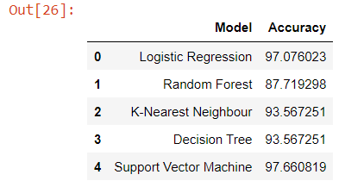

Slide 25
This Project can be done in total of 5 ways which are given above. After Testing each method, we came to know which method gives most accurate outcome
In this project, logistic regression, k-nearest neighbor, support vector machine, random forest, decision tree, and naïve Bayes classification algorithms were created, and accuracy scores for each of them were obtained. Each algorithm was applied to three different datasets that included various features. The first dataset covered all independent features, the second dataset included highly correlated features, and the last dataset included low correlated features. Three different datasets were used separately for each machine learning technique, and accuracy results were obtained to make comparisons. SVM gave better accuracy results rather than the other methods. The main advantage of SVM is that it is very efficient to train. In addition, the SVM model is useful and gives more accurate results in complex algorithms. A competitive performance was demonstrated when dealing with imbalanced data (97.66% accuracy).

Slide 26


